Slide 1
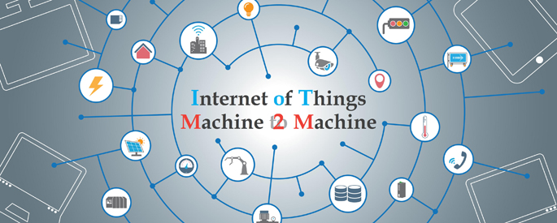
Unit iv
Ms. Kritika Purohit
Assistant Professor
Computer Science & Engineering

Slide 2
Points to be covered-
M2M: Machine to Machine –Introduction
IoT vs M2M: Difference and Similarities
Software Defined Networks
Network Function Virtualization
SDN vs NFV for IoT

Slide 3
Introduction to M2M
M2M refers to those solutions that allow communication between devices of the same type and a specific application, all via wired or wireless communication networks. M2M solutions allow end-users to capture data about events from assets, such as temperature or inventory levels.
M2M is deployed to achieve productivity gains, reduce costs, and increase safety or security.
M2M has been applied in many different scenarios, including the remote monitoring and control of enterprise assets, or to provide connectivity of remote machine-type devices.
M2M solutions, however, do not allow for the broad sharing of data or connection of the devices in question directly to the Internet.

Slide 4
M2M Solution System- A typical M2M system solution consists of M2M devices, communication networks that provide remote connectivity for the devices, service enablement and application logic, and integration of the M2M application into the business processes provided by an Information Technology (IT) system of the enterprise.
The M2M system solution is used to remotely monitor and control enterprise assets of various kinds, and to integrate those assets into the business processes of the enterprise in question.
The asset can be of a wide range of types (e.g. vehicle, freight container, building, or smart electricity meter), all depending on the enterprise.

Slide 5
The system components of an M2M solution are as follows:-
M2M Device: This is the M2M device attached to the asset of interest, and provides sensing and actuation capabilities. The M2M device is here generalized, as there are a number of different realizations of these devices, ranging from low-end sensor nodes to high-end complex devices with multimodal sensing capabilities.
Network: The purpose of the network is to provide remote connectivity between the M2M device and the application-side servers. Many different network types can be used, and include both Wide Area Networks (WANs) and Local Area Networks (LANs), sometimes also referred to as Capillary Networks or M2M Area Networks. Examples of WANs are public cellular mobile networks, fixed private networks, or even satellite links.

Slide 6
M2M Service Enablement: This component provides generic functionality that is common across a number of different applications. Its primary purpose is to reduce cost for implementation and ease of application development.
M2M Application: The application component of the solution is a realization of the highly specific monitor and control process. The application is further integrated into the overall business process system of the enterprise. The process of remotely monitoring and controlling assets can be of many different types, for instance, remote car diagnostics or electricity meter data management.

Slide 7
Key application areas of M2M-
Metering applications, meanwhile, include primarily remote meter management and data collection for energy consumption in the electricity utility sector, but also for gas and water consumption.
Remote monitoring is more generalized monitoring of assets and includes remote patient monitoring as one prime example.
Fleet management includes several different applications, like data logging, goods and vehicle positioning, and security of valuable or hazardous goods.
Security applications are mainly those related to home alarms and small business surveillance solutions. The final market segment is Automated Teller Machines (ATM) and Point of Sales (POS) terminals.

Slide 8
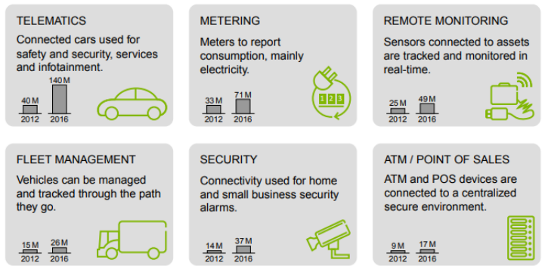

Slide 9
IoT vs M2M
Parameters | IoT | M2M
Intelligence | Devices have objects that are responsible for decision making | Some degree of intelligence is observed in this
Connection Type | The connection is via Network and using various communication types. | The connection is a point to point
Communication Protocol | Internet protocols are used such as HTTP, FTP, and Telnet. | Traditional protocols and communication techniques are used
Data Sharing | Data is shared between other applications that are used to improve the end-user experience. | Data is shared with only the communicating parties.
Internet | Required for communication. | Devices are not internet-dependent
Scope | A large scope. | Limited Scope for devices.
Business Type | Business 2 Business(B2B) and Business 2 Consumer(B2C) | Business 2 Business (B2B)
Open API Support | Support for Open Api’s | No support for Open Api’s
Example | Smart wearables, Big Data and Cloud, etc. | Sensors, Data and Information etc.

Slide 10
Software defined Networks
Control Plane- In Routing control plane refers to the all functions and processes that determine which path to use to send the packet or frame. Control plane is responsible for populating the routing table, drawing network topology, forwarding table and hence enabling the data plane functions. Means here the router makes its decision. It is responsible for How packets should be forwarded.
Data Plane- In Routing data plane refers to all the functions and processes that forward packets/frames from one interface to another based on control plane logic. Routing table, forwarding table and the routing logic constitute the data plane function. Data plane packet goes through the router and incoming and outgoing of frames are done based on control plane logic. It is responsible for moving packets from source to destination. It is also called as Forwarding plane.

Slide 11
Software Define Network is a separation between the control plane and data plane and provides vendor independence. In SDN, the control plane is decoupled from forwarding plane and communication between two planes is done through APIs. SDN architecture separates the network into three distinguishable layers, connected through northbound and southbound APIs-
The application layer- The application layer, not surprisingly, contains the typical network applications or functions organizations use, which can include intrusion detection systems, load balancing or firewalls.
The control layer- The control layer represents the centralized SDN controller software that acts as the brain of the software-defined network. This controller resides on a server and manages policies and the flow of traffic throughout the network.

Slide 12
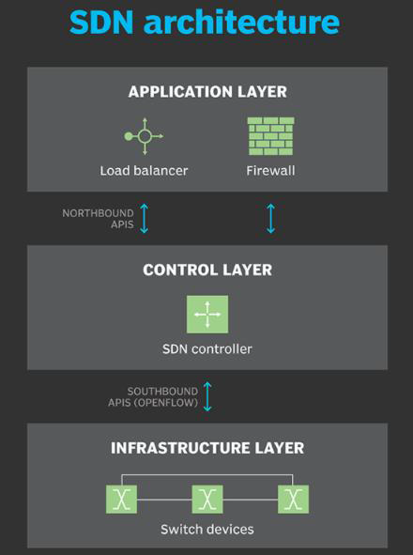
The infrastructure layer- The infrastructure layer is made up of the physical switches in the network.

Slide 13
How SDN Works ?
SDN encompasses several types of technologies, including functional separation, network virtualization and automation through programmability.
Originally, SDN technology focused solely on separation of the network control plane from the data plane. While the control plane makes decisions about how packets should flow through the network, the data plane actually moves packets from place to place.
In a classic SDN scenario, a packet arrives at a network switch, and rules built into the switch's proprietary firmware tell the switch where to forward the packet. These packet-handling rules are sent to the switch from the centralized controller.
The switch - also known as a data plane device - queries the controller for guidance as needed, and it provides the controller with information about traffic it handles. The switch sends every packet going to the same destination along the same path and treats all the packets the exact same way.

Slide 14
Benefits of SDN-
An administrator can change any network switch's rules when necessary -- prioritizing, deprioritizing or even blocking specific types of packets with a granular level of control and security.
Network Management
End-to-End Visibility.
Virtualizes hardware and services that were previously carried out by dedicated hardware.
Software-defined networking contributed to the emergence of software-defined wide area network (SD-WAN) technology. SD-WAN employs the virtual overlay aspect of SDN technology, abstracting an organization's connectivity links throughout its WAN and creating a virtual network that can use whichever connection the controller deems fit to send traffic.

Slide 15
Challenges with SDN-
Security is both a benefit and a concern with SDN technology. The centralized SDN controller presents a single point of failure and, if targeted by an attacker, can prove detrimental to the network.
No established definition of software-defined networking in the networking industry.
Some networking initiatives are often mistaken for SDN, including white box networking, network disaggregation, network automation and programmable networking. While SDN can benefit and work with these technologies and processes, it remains a separate technology.
Main adopters of SDN include service providers, network operators, telecoms and carriers, along with large companies, such as Facebook and Google, all of which have the resources to tackle and contribute to an emerging technology.

Slide 16
Use cases of SDN-
DevOps - An approach based on software-defined networking can facilitate DevOps by automating app updates and deployments, including automating IT infrastructure components as the DevOps apps and platforms are deployed.
Campus networks - Campus networks can be difficult to manage, especially with the ongoing need to unify Wi-Fi and Ethernet networks. SDN controllers can benefit campus networks by offering centralized management and automation, improved security and application-level quality of service across the network.
Service provider networks - SDN helps service providers simplify and automate the provisioning of their networks for end-to-end network and service management and control.
Data center security - SDN supports more targeted protection and simplifies firewall administration.

Slide 17
Network functions virtualization
Network functions virtualization (NFV) is a network architecture concept that uses the proven technologies of IT virtualization.
NFV is designed to deliver the network services needed to support an infrastructure totally independent from hardware by decoupling network functions from proprietary purpose-built hardware appliances.
The software that provides these network services are known as virtual network functions (VNF) and run on generic hardware.
The major components of an NFV architecture include the virtualized network functions (VNFs), NFV Infrastructure (NFVI) and NFV management and orchestration (MANO).

Slide 19
Network Functions Virtualization Infrastructure-
The NVFI is based on low cost, standardized x86 computing hardware and software—hypervisors, virtual machines and virtual infrastructure managers that enable the physical and virtual network layers.
It delivers the physical resources—compute, storage and network and software on which VNFs are deployed and managed.
The NFVI provides the virtualization layer that sits above the hardware and abstracts hardware resources so they can be logically partitioned and provisioned to support VNFs.
The NFVI is also critical in building complex, widely distributed networks without the geographic limitations associated with traditional network architectures.

Slide 20
Virtual Network Functions-
Virtualized network functions run in one or more virtual machines on top of the hardware networking infrastructure.
VNFs include routers, switches, SD-WAN, firewalls and a growing number of other network services now available as software from vendors like Cisco, Juniper Networks and Palo Alto Networks.
With a network functions virtualization architecture, VNFs are deployed on-demand, eliminating the deployment delays associated with traditional network hardware, as well as the need for on-site technical skills when remotely deployed.
VNFs provide the agility needed to anticipate or respond to dynamic network performance or expansion demands in hybrid and multicloud environments.

Slide 21
NFV Management and Network Orchestration-
NFV MANO coordinates resources -the NFVI as well as VNFs- running in a virtualized data center including compute, networking, storage and virtual machines (VM). NFV MANO uses templates for standard VNFs that allow architects to select the appropriate NFVI resources to be deployed.
NFV MANO is comprised of three functional areas:
NFV Orchestrator handles VNF onboarding, lifecycle management, global resource management and validation and authorization of NFVI resource requests.
VNF Manager controls VNF lifecycle management of instances, providing a coordination and adaptation role for NFVI and Element/Network Management Systems configuration and event reporting.
Virtual Infrastructure Manager controls and manages the NFVI compute, storage and network resources.

Slide 22
SDN vs NFV: Similarities - In many ways, SDN and NFV are interdependent, but when deployed together can achieve flexible, agile network infrastructures. NFV provides the basic networking functions and SDN assumes higher-level management responsibility to orchestrate overall network operations.
Parameter | SDN | NFV
Development | Running on virtual machines, hypervisors, network controllers, load balancers and gateways are deployed and configured to provide the needed network infrastructure controls. | A wide range of virtualized network functions such as routers, firewalls and SD-WAN are deployed as software on top of virtualized infrastructure.
Management | Centralized control console to monitor throughput, routing and policy definitions. | VNFs are centrally managed and monitored regardless of where they are located across the network.

Slide 23
Parameter | SDN | NFV
Flexibility | The primary cost savings come from the reduction of operational expenses through the automation of network configuration, adds and changes. Personnel costs account for much of the overall spend, so a small reduction in operational costs can lead to a significant cost-benefit. | Running on high-performance servers in data centers, VNFs eliminate the need to procure specialized network hardware for each individual network function. This allows for less space, power, cooling and equipment to be deployed.
Cost | Easily adjust network-wide traffic flow in anticipation of, or in response to, changing business needs. Programmable interfaces enable provisioning of new network devices, reconfiguration of existing devices via scripting and/or management consoles. | Quickly deploy and decommission functions to support proof-of-concept trials. Locate functions at the network edge, close to data, applications and users to optimize network security and performance.

Slide 24
SDN vs NFV: Differences-
Parameter | SDN | NFV
Scope | Defines the big-picture aspects of the entire network—the type of infrastructure, services and applications available. Determines network policies that guide the delivery and use of network resources. Hypervisor orchestrates and controls lower-level network functions. | Deliver a wide range of specific functionalities that must be performed at all levels and stages of a network – at the periphery, boundary and core—under the control of a hypervisor
Standards | Open Network Foundation seeks to develop ―various open standards, as well as vendor-neutral standards, for the communications interface defined between the control and forwarding layers of an SDN architecture. | European Telecommunications Standards Institute (ETSI) defines and maintains ―globally applicable standards for information and telecommunications technologies regarding NFV.

Slide 25
Virtual Network Functions Deployed Across a SDN-Based Global Network- Virtual network functions deployed via Network Edge are enabling enterprises to take advantage of SDN capabilities to modernize networks deliver new services, establishing new connections, and optimizing performance.
Cloud-to-cloud routing—Virtual routers deployed at Equinix data centers eliminate backhaul delays by establishing secure, ultra-low latency connections between applications and data hosted in two different clouds.
Hybrid cloud firewall—Virtual firewalls protect corporate networks from attacks from public-facing applications hosted on public clouds.
Branch-to-cloud SD-WAN—Use interconnection hubs at Equinix to optimize connectivity between distributed branch locations, cloud providers and SaaS providers.

